Slide 1
Integrated programmes for pedagogical change: Overhauling thinking on teaching to incorporate new technologies
Steve Williams
Newcastle University
BETT – London – 31 January 2013

Slide 2
Guiding thought
Best practice is to have academic leaders, practicing academics, teaching quality people and IT people around the same tables.
This leads to a well-integrated, sustainable programme, which in turn leads to benefits for students and staff.
Communication of the benefits at programme and project level, good project management and proper, early resourcing are essential.

Slide 3
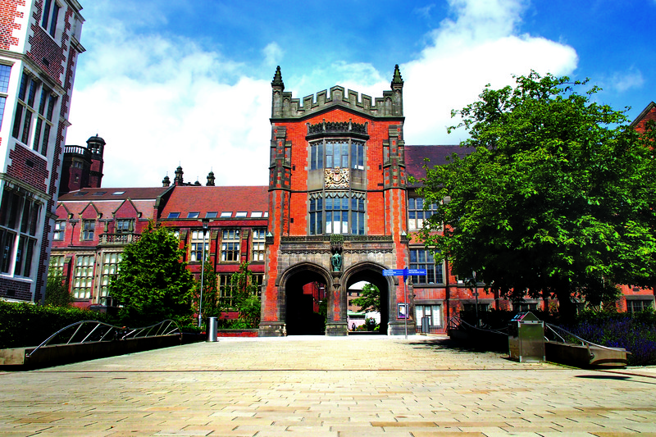
Newcastle University

Slide 4
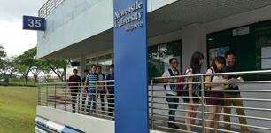

Newcastle University
But also…

Slide 5
Students’ expectations
For £9k PA, high!
Feedback, contact hours, quality tutoring
IT that just works
My device, my way, now, at no cost to me.
“But also you need to provide more computers…
… and more printers.”
Social networking?
On many sites, around the world.

Slide 6
Academic colleagues’ expectations
Somewhere to put my material
And interact with my students
And give and receive feedback
Without me needing to do any training or change my current processes!
Social networking?

Slide 7
Academic colleagues’ expectations
“Do you mean that I should invest in computers instead of lecturers? Are you mad?”

Slide 8
Project 2012
How did we get into it?
Desired outcomes / benefits
Programme governance
Project Management
KPI and scorecard reporting
90
Lines!

Slide 9
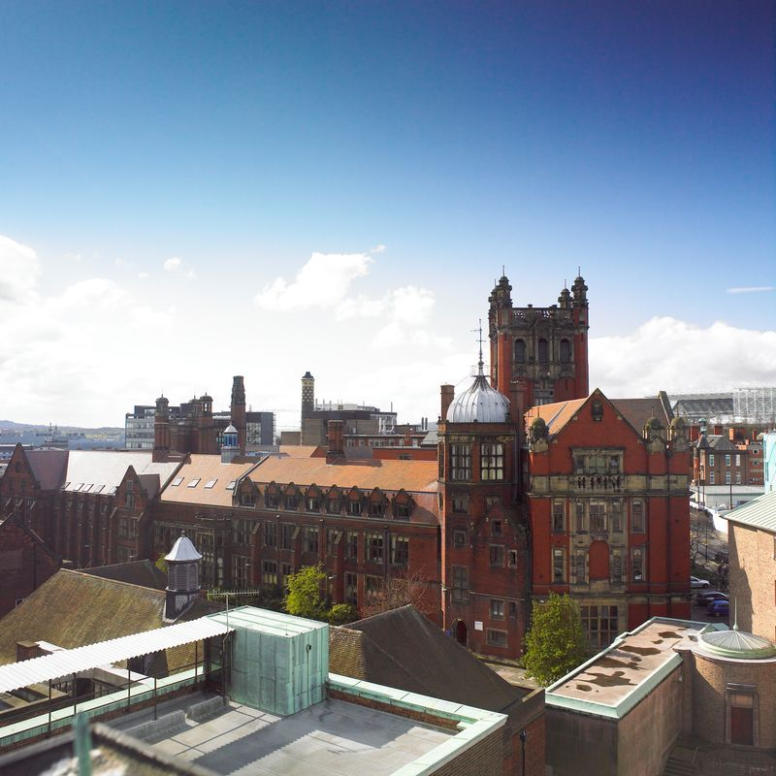
Project 2012 – what went well and badly?
Real PVC / UTLC commitment
Well motivated staff
Student involvement
Doing it as a programme
More piloting, in different academic domains
‘Initiative overload’

Slide 10
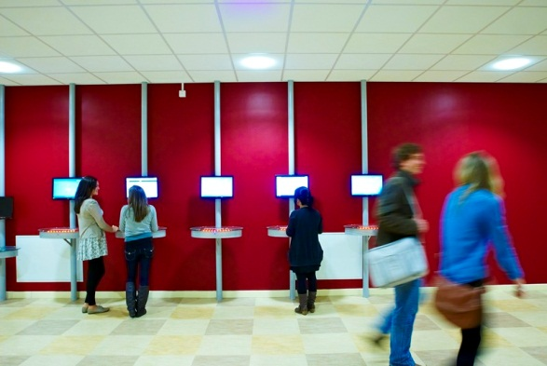
Project 2012 – where are we now?
L+T Directors in each School
Careers, feedback, tutoring…
More 24/7 – Library/Clusters
Lecture capture
VLE threshold and experts
Mobile VLE
Apps – native, iOS, Android
Social media
Staff Student Committee membership
Better relationships
Key issue – some of this is IT, some is nothing to do with IT!

Slide 11
Project 2012 – where are we now?
“Every one of our students does e-Learning”

Slide 12
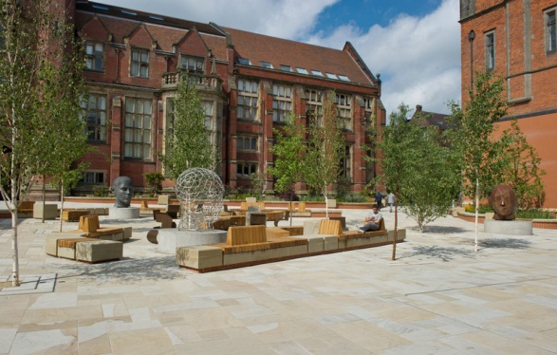
What’s next…
Flexible programmes?
MOOCs?
CPD/professional accreditation?
More internationalisation?
Rebrand as ‘student offer’ / transition to normal / embed what we have.

